Slide 1

Inclusive Education :The Challenge of Implementation
Richard Rieser
CEO World of Inclusion
www.worldofinclusion.com
rlrieser@gmail.com

Slide 2


LEAVE NO ONE BEHIND!!!

Slide 3
SDG Indicators Goal 4 Education &Disability
Goal 4. Ensure inclusive and equitable quality education and promote lifelong learning opportunities for all
4.5 By 2030, eliminate gender disparities in education and ensure equal access to all levels of education and vocational training for the vulnerable, including persons with disabilities, indigenous peoples and children in vulnerable situations
4.5.1 Parity indices (female/male, rural/urban, bottom/top wealth quintile and others such as disability status, indigenous peoples and conflict-affected, as data become available) for all education indicators on this list that can be disaggregated
4.a Build and upgrade education facilities that are child, disability and gender sensitive and provide safe, nonviolent, inclusive and effective learning environments for all
4.a.1 Proportion of schools with access to: (a) electricity; (b) the Internet for pedagogical purposes; (c) computers for pedagogical purposes; (d) adapted infrastructure and materials for students with disabilities; (e) basic drinking water; (f) single-sex basic sanitation facilities; and (g) basic handwashing facilities (as per the WASH indicator definitions)

Slide 4

"EDUCATION is the most POWERFUL weapon which you can use to CHANGE the WORLD"
We must build a powerful grass roots Global Campaign for inclusive education- of Parents, Young People, Young Disabled People, DPOs, Teachers and Governments, Disabled Adults and NGOs, UNICEF,UNESCO, World Bank, UNDESA.
All Means All

Slide 5

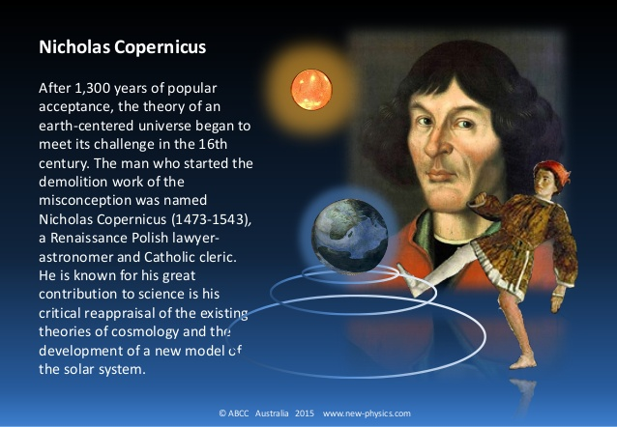
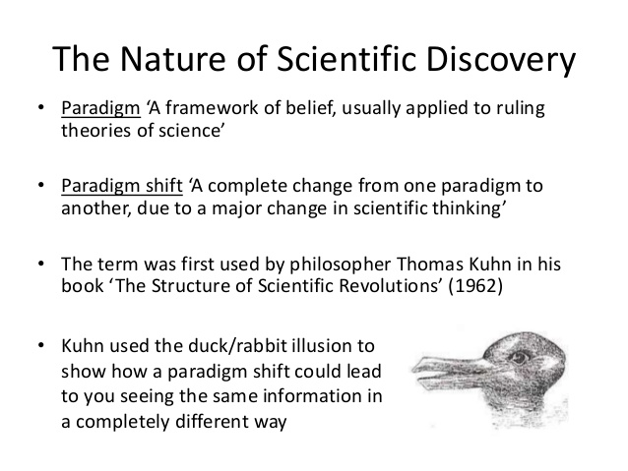
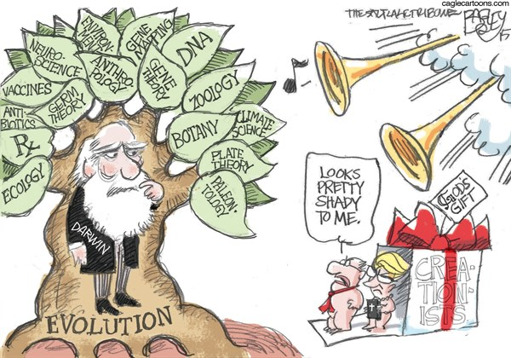
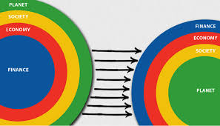

Slide 6
Paradigm Shift at Core of UNCRPD
“The Convention follows decades of work by the United Nations to change attitudes and approaches to persons with disabilities. It takes to a new height the movement from viewing persons with disabilities as "objects" of charity, medical treatment and social protection towards viewing persons with disabilities as "subjects" with rights, who are capable of claiming those rights and making decisions for their lives based on their free and informed consent as well as being active members of society”. UN DESA

Slide 7
Formulating the Paradigm Shift
Following UPIAS in UK it was in 1981 that Disabled People International first recognised the difference between our impairments and disability.
Impairment is the loss or limitation of physical, mental or sensory function on a long term, or permanent basis.
Disablement (Handicap at the time) is the loss or limitation of opportunities to take part in the normal life of the community on an equal level with others due to physical and social barriers. (Disabled People's International 1981)
This definition allowed the burgeoning Disability Movement to use the ‘social model’ to analyse the oppression people with disabilities faced and to campaign for a fundamental change in attitudes and practices as a human rights issue. This analysis led directly to the UNCRPD 25 years later.

Slide 8
In many parts of the world Traditional Ideas about disability are still dominant
Training participants Southern Africa and South Pacific give many examples of myth, superstition and magic causes to be:-
Demon Possessed
Bewitched/cursed
Tools for begging
Contagious
Shameful
A Burden
Asexual, cure for AIDS
Cannot be educated
Laughable
Because your parents did something wrong
Angry spirits
Broke a taboo
Pregnant woman saw or ate something
Your own fault
Wrong Marriage
Worshipping Animals
Misuse bride price

Slide 10
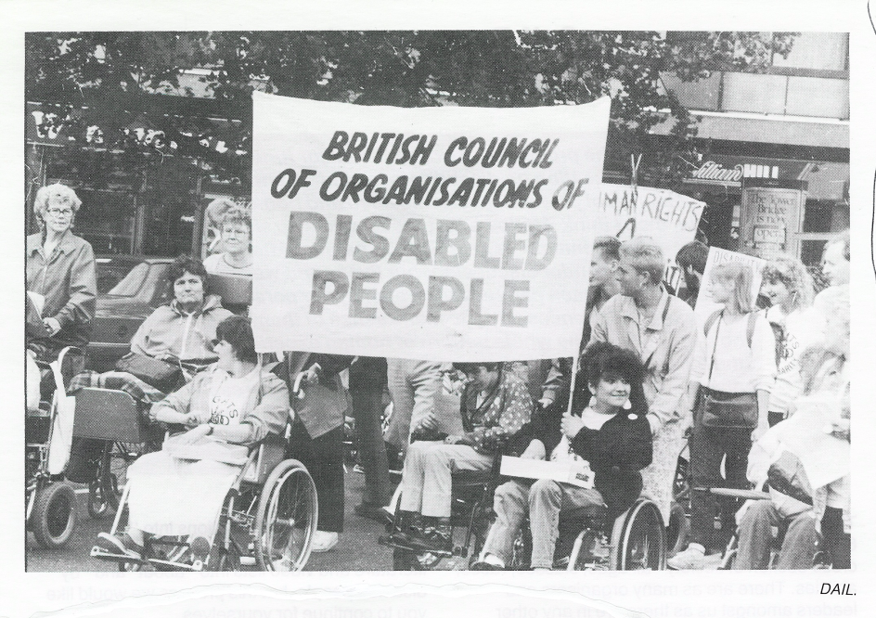
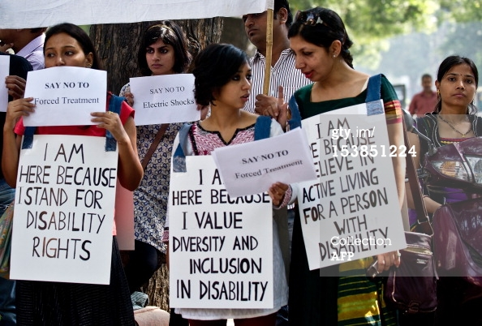
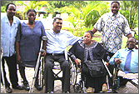
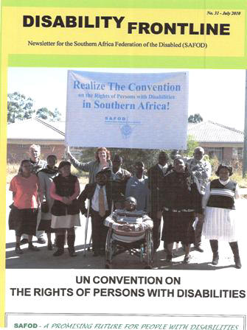
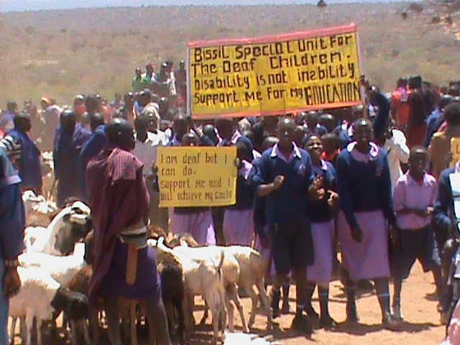
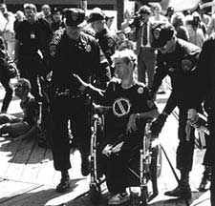
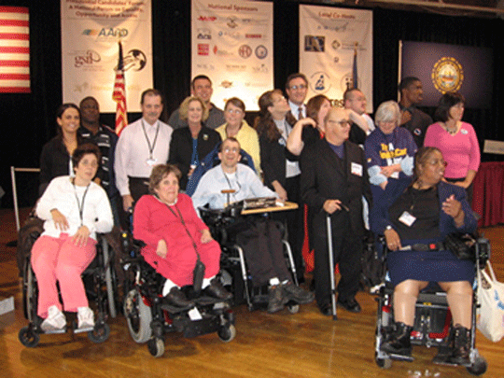
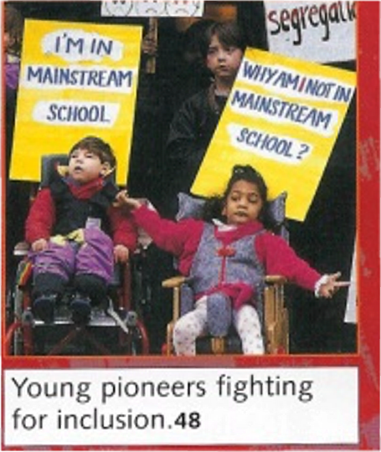
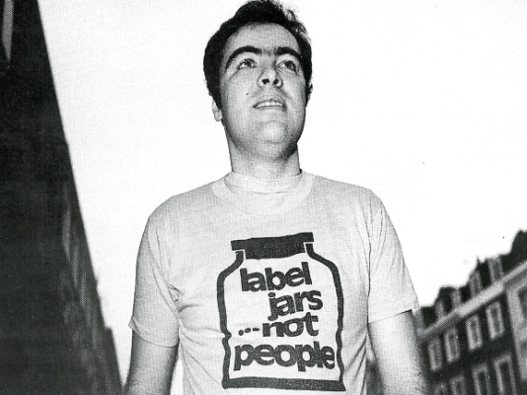
Struggles of Parents and Disabled People for Inclusion
Disabled People & Parents Organise and Fight Back
Nothing About Us Without Us!
People First- People with learning Difficulties 1984

Slide 12
Types of thinking about disabled people and forms of education.
Thinking/Model | Characteristics | Form of Education
Traditional | DP a shame on family, guilt, ignorance. DP seen as of no value. | Excluded from education altogether.
Medical 1 | Focus on what DP cannot do. Attempt to normalize or if cannot make to fit into things as they are keep them separate. | Segregation Institutions/ hospitals Special schools (with ‘expert’ special educators)
Medical 2 | Person can be supported by minor adjustment and support, to function normally and minimize their impairment. Continuum of provision based on severity and type of impairment. | Integration in mainstream:- a)At same location-in separate class/units b)Socially in some activities e.g. meals, assembly or art. c)In the class with support, but teaching & learning remain the same. What you cannot do determines which form of education you receive.
Social Model | Barriers Identified-solutions found to minimize them. Barriers of attitude, environment and organization are seen as what disables and are removed to maximize potential of all. DP welcomed . Relations are intentionally built. DP achieve their potential. Person centred approach. | Inclusive education- schools where all are welcomed and staff, parents and pupils value diversity and support is provided so all can be successful academically and socially. This requires reorganizing teaching, learning and assessment. Peer support is encouraged. Focus on what you can do.

Slide 13
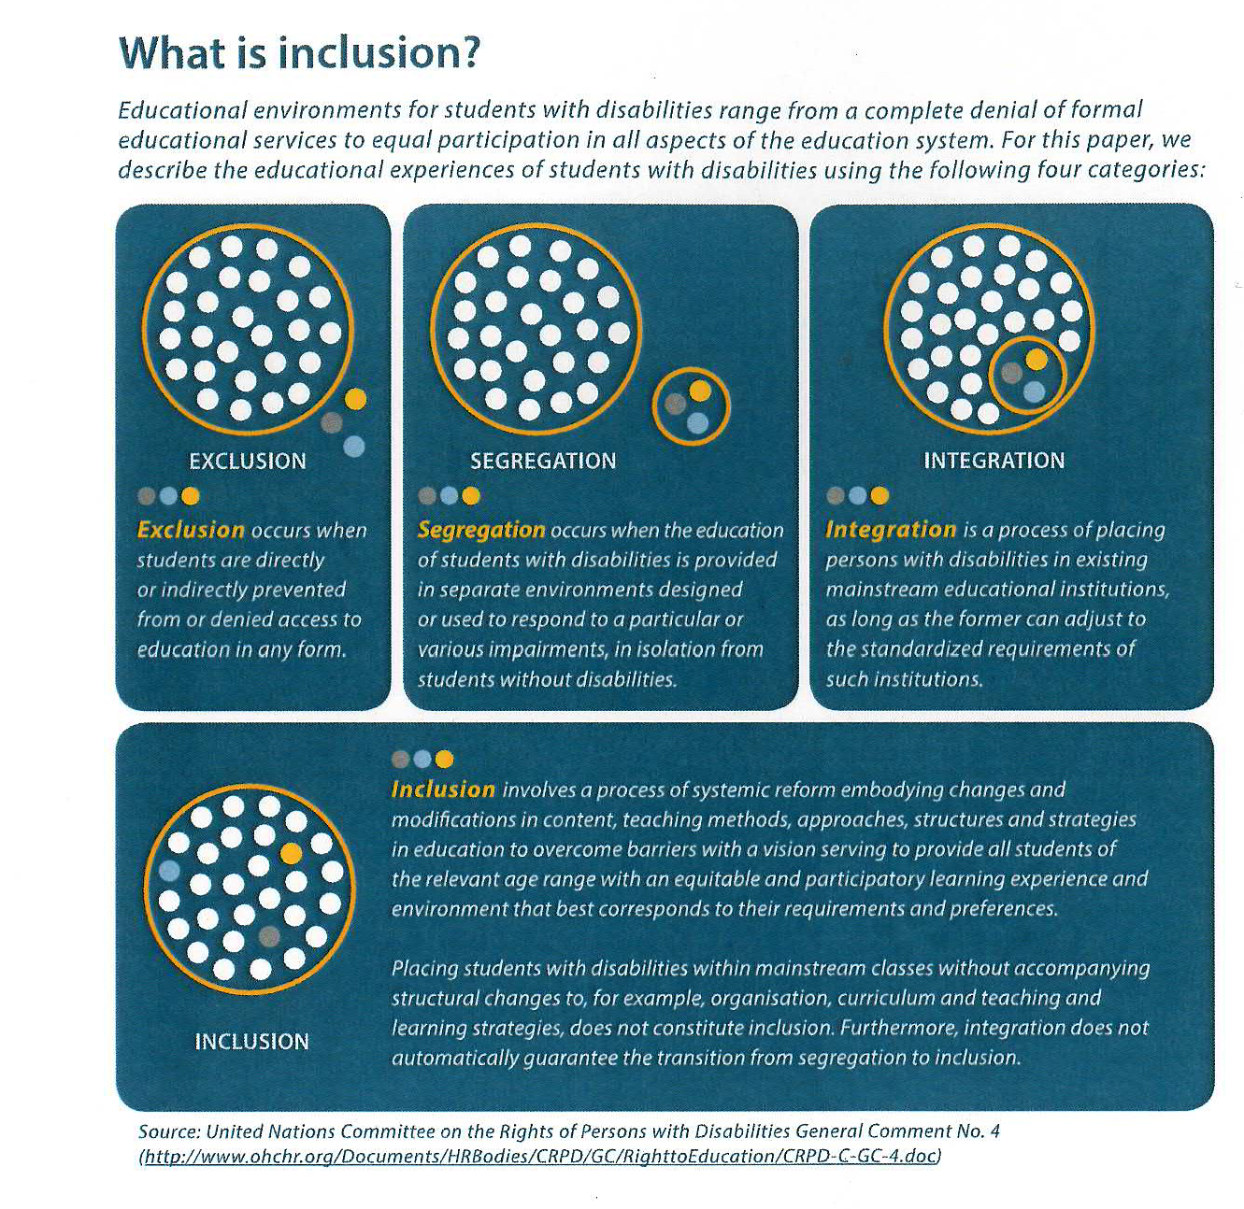
Para 11

Slide 14
Medical and Social Model Thinking applied to education^{[1]}
^{[1]} Adapted from Micheline Mason 1994, Altogether Better, Comic Relief & R. Rieser 2000
MEDICAL MODEL THINKING | SOCIAL MODEL THINKING
Child is faulty | Child is Valued
Diagnosis | Strengths and Needs defined by self and others
Labelling | Identify Barriers and develop solutions
Impairment becomes Focus of attention | Outcome based programme designed
Assessment, monitoring, programmes of therapy imposed | Resources are made available to Ordinary services
Segregation and alternative services | Training for Parents and Professionals
Ordinary needs put on hold | Relationships nurtured
Re-entry if normal enough or Permanent Exclusion | Diversity Welcomed Child is Included
Society remains unchanged | Society Evolves

Slide 15
It's the barriers that disable !
Negative
Attitudes
Inaccesible
Environments
Bullying
Use of Resources
Poor Peer Support
Inflexible Curriculum &
Assessment
Lack of Communication
Lack of Role Models
Ignorance
Poor Teaching
Fear
Low Expectations

Slide 16
Putting the Paradigm Shift into Practice in Education
“Special education in developed countries, but also in developing countries, can help create and reiterate negative stereotypes towards students and persons with disabilities. Additionally, the removal of children with disabilities from the mainstream education denies students without disabilities access to the experience of disability, which in turn perpetuates ignorance and stigma.
The social model of disability reflected in the CRPD, recognizing the combination of a person’s impairment situated in a discriminating society, requires changing the social system, which includes the education system. Special education today reproduces the discriminatory social system by reinforcing the assumption that individuals with specific characteristics do not fit in society and thus places them in separate situations.” IDA 2011
All teachers need Disability Equality Training delivered by trainers with disabilities to challenge negative attitudes and promote social model thinking.

Slide 17

160
88
172
90
Jan 2017

Slide 18
UNCRPD Article 24 Education
Requires all signatories to ensure all disabled children and young people can fully participate in the state education system and that this should be an ‘inclusive education system at all levels’
The development by persons with disabilities of their personality, talents and creativity, as well as their mental and physical abilities, to their fullest potential.
This right is to be delivered within an inclusive primary and secondary education system, from which disabled people should not be excluded.
Reasonable accommodations should be provided for individual requirements and support provided in individualised programmes to facilitate their effective social and academic education.

Slide 19
UNCRPD Article 24 Education -2
Instruction in Braille , Sign language AAC
Employment of disabled teachers
Train professionals and staff who work at all levels of education. Such training shall incorporate disability awareness and the use of appropriate augmentative and alternative modes, means and formats of communication, educational techniques and materials to support persons with disabilities
General Comment Article UNOHCHR Sept 2016
Article 8 b-Awareness Raising ‘Fostering at all levels of the education system, including in all children from an early age, an attitude of respect for the rights of persons with disabilities’

Slide 20
Statistics: Education and Children with Disabilities
Over 1 Billion or 15% disabled people in the world, children with disabilities in the majority world will be 250-350 million. Twice current estimates.
Plan International found 90% CWD they support not in school
Despite success of Education for All, with 95% enrolled in primary, a larger proportion of 65m not in school are children with disabilities-50% +
Drop out and failure to complete primary is higher. Many millions more Children anf Young People with Disabilities
Lack of Transition to secondary and higher education - much higher. Only 1-2% C&YPWD
Many states only record 2-3% of children as disabled. Recent work through UN Statistics in selected countries puts it at 14%-20%.
Important work at all levels to monitor and disaggregate date UNICEF and Washington Group

Slide 21
Why are so few children with disabilities accessing and completing basic education? Finding from the UNICEF REAP Project 1.
Generalised approaches of the inclusion of all excluded groups are not sufficient. Education for All and Millennium Development Goal 2 have talked of All, without the specifics of the training and accommodation of meeting different impairment needs. Must change now SDGs
Reactions to categorical medical model/deficit SEN approaches has led to its replacement with generalised inclusion principles. Still need to be specific to provide support and reasonable adjustments

Slide 22
Why are so few children with disabilities accessing and completing basic education? 2.
This leaves most teachers believing that the expertise for, and the inclusion of, children with disabilities, is someone else’s expertise and responsibility.
What is needed is twin track approach, with mandatory training, for all teachers on how to meet impairment specific needs, as well as, more general training on developing child friendly classrooms for all. Backed up by disability specialist local resource centres and teachers.

Slide 23
Track Two
Education accommodating
the different impairment specific needs of
children with disabilities.
Blind And Visually Impaired
Braille, Tactile Maps
Tapes and Text to Talk,
Mobility Training,
Large Print, Magnification,
Orientation,
Auditory Environment &
Talking instruments
Deaf & Hearing Impaired
Sign Language Taught &
Interpretation,
Oral/Finger Spelling,
Hearing Aid Support, Visual Environments
Speech & Communication
Facilitated Communication,
Augmented Communication,
Switching,
Talkers,
Information Grids.
Mental Health and Behaviour
Counselling and
Personal support,
Differentiated
Behaviour Policy, Empathy
Quiet /chill out space,
Circle of Friends,
Differentiated Behaviour Policy, Structured Day.
Physical Impairment
Accessible Infra-structure.
Toilets, Furniture
Equipment, prosthesis,
Personal Assistance
Diet, Transport,
Medication.
Specific Learning Difficulty
Colour overlays & background
Easy Read
Tapes and Text to Talk
Spell- checker
Concrete objects
General Cognitive Impairment
Pictograms, Small Steps Curriculum, Easy Read, Scaffolding, Makaton, Symbols, Info. Grids,
Concrete objects
Screening, identification and key adjustments for main impairments
Deaf Blind Language,
Interpreters,
Tactile Environment,
Orientation
Foundations
Identifying Barriers-Finding Solutions
Equality and Valuing Difference
Collaborative Learning
Peer Support
Track One
Education based on Principles of
Equality and Child
Empowerment.
Differentiation & Flexible Curriculum and Assessment
Stimulating and Interesting Multi-Sensory Learning Environment
Anti Bias Curriculum
Child Centred Pedagogy, Creative with Reflective Teachers
Quality education requiring rigour and effort for each child to achieve their potential

Slide 24

Training routes and options for teachers’ professional development for inclusion of children with disabilities.
In-service /Continuing Professional Development- twin track.
Whole school staff training all teaching staff
Withdrawal for selected teachers to cascade to colleagues
Individual teachers undertake further award bearing study leading to Diploma, B.Ed or Masters in Inclusive Education
School based/district training with external tutor leading to additional qualification.
All need monitoring and follow up on implementation.
Leadership Training for Inclusion
Principals/headteachers and local administrators need to have training on both tracks
Training on best ways of managing and delivering training of colleagues.
Resource teachers trained in both tracks with specialism in one or more impairment specific area.
To work across a district from a local resource centre providing on going mentoring, support and monitoring
Initial or Pre-Service-twin track
College based-2 or 3 years.
Lecturers need knowledge ,skills and understanding including children with disabilities
Students need practicum in schools with good practice
School based
Need school based mentors
Distance learning using ICT,TV,DVD,
Study leave and taught courses
Teachers need decent salaries and conditions, incentives to complete additional training for inclusion and for deployment to hard to reach areas. Quality needs monitoring.

Slide 25
Four key questions to help develop inclusive practice in lesson preparation.
1. As you are planning any lesson for pupils ask yourself what are the essential knowledge, skills or understanding you want all students to get from the lesson?
2. How do my pupils learn best? Take account of learning styles. Most pupils can learn in visual, auditory or kinaesthetic ways, though most have a preference and it is good to know these.
3. What modifications to the lesson plan would permit more pupils to learn more effectively in my classroom? All teachers are very used to modifying their lessons to enhance their pupils learning.
4. How will my pupils show what they have learned? Ask the pupils to respond in ways they can handle. Assess pupils through their strengths not their weaknesses.
Gary Bunch How to Book of Inclusion
Notes:
For the inclusive classroom what is essential and how do you make sure all pupils have learned it at their own level.

Slide 26
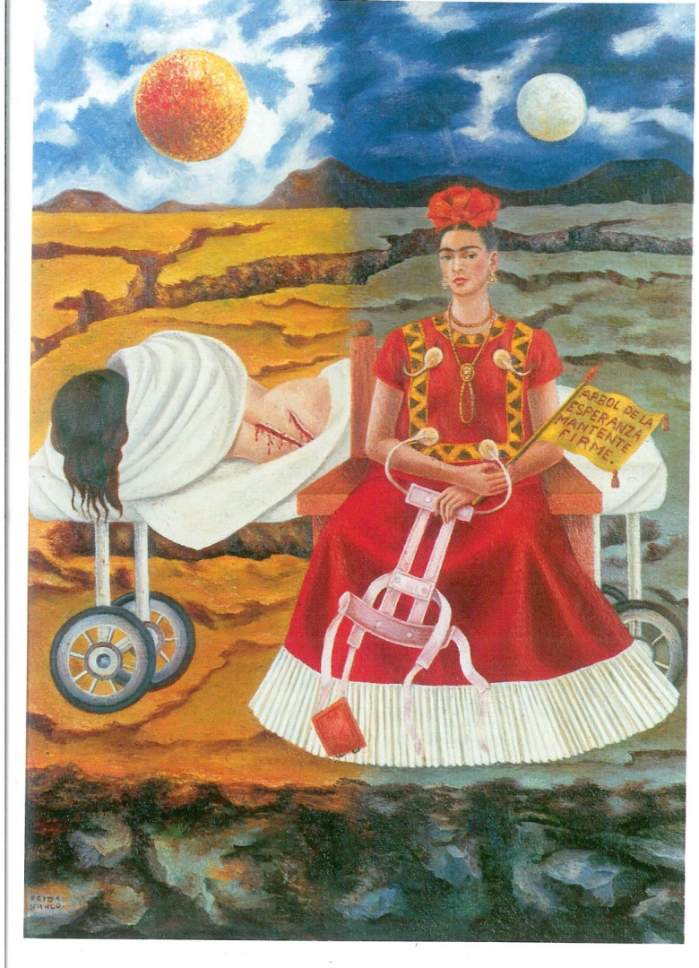
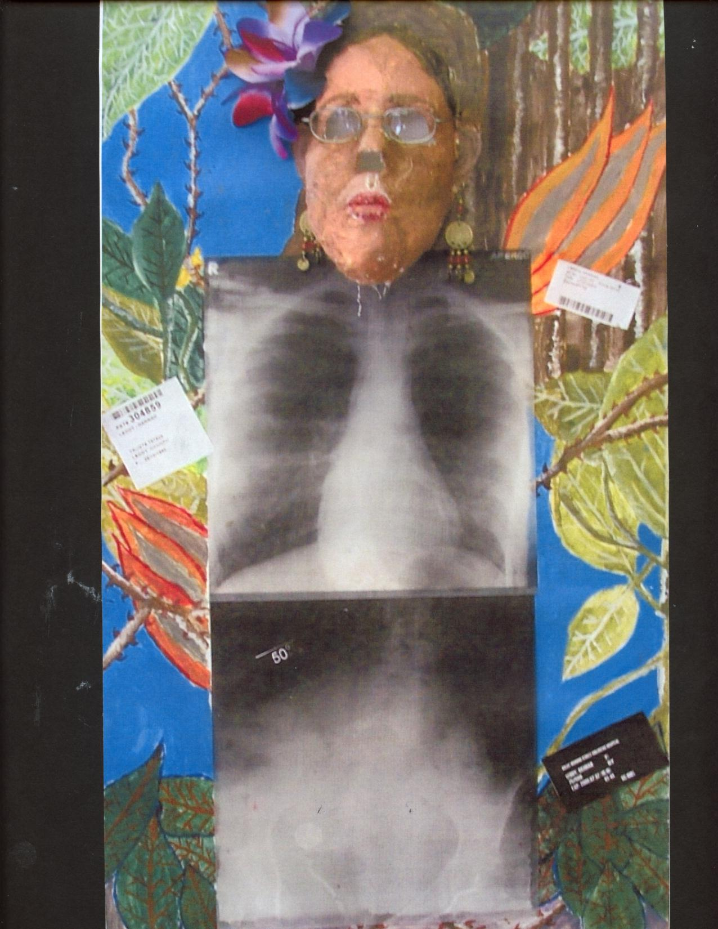
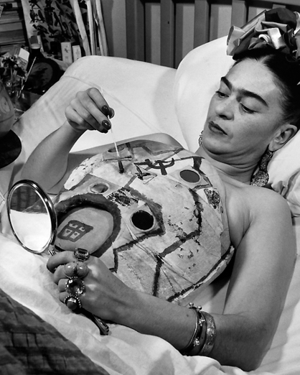
Disability in the Curriculum
Art of Frida Kahlo
Frida in Plaster Cast
Tree of Hope Keep Firm 1946
A disabled student draws inspiration from Frida Kahlo

Slide 27
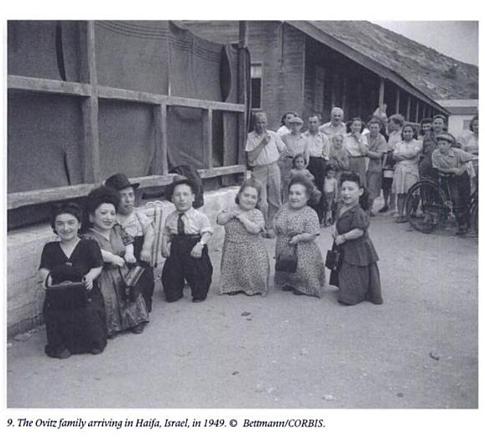
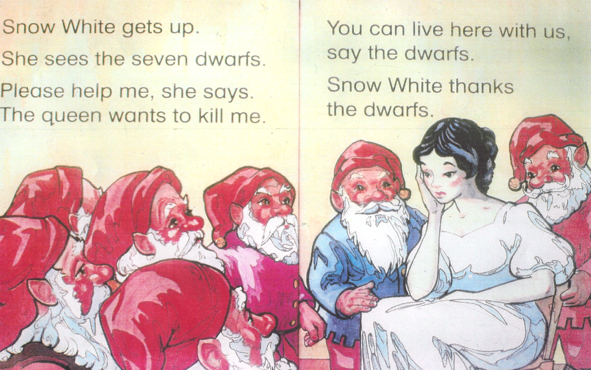
The story of the real ‘7 Dwarves’ or little people
The Ovitz family were a family of Romanian- born Jewish circus actors/travelling musicians who survived imprisonment at the at Auschwitz concentration camp and experiments on them by Josef Mengele. They went to live in Israel and carried on with their performances. However their health was badly effected by the treatment they received.
Throughout their lives they stuck together with their non-disabled siblings and refused to take part in freak shows considering themselves professional actors, musicians and singers
See Yehuda Koren, Eilat Negev, In Our Hearts We Were Giants - the Remarkable story of the Lilliput Troupe, 2004

Slide 28

Raising Disability in the Curriculum:Film
www.bfi.org.uk/disablingimagery
Notes:
Media or use court cases which the judicuary demonstrate disablilist views for discussion with older children

Slide 29
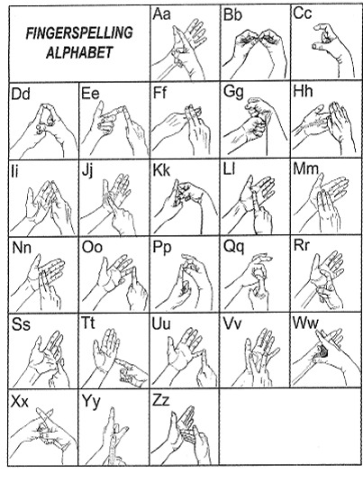
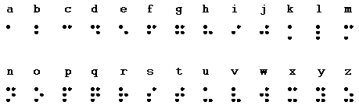

Maths and the Braille System
Get pupils to work out how many different permutations you can get on the six pattern of a dice?

Slide 30
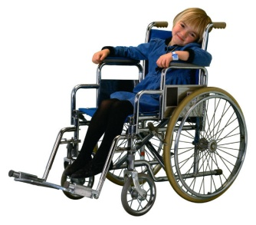
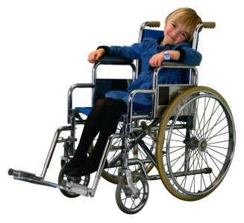
Gradients-What is the right angle for as wheelchair?
Too steep-dangerous
Too gentle-tiring
Answer -Between 1 in 20 and 1 in 12

Slide 31
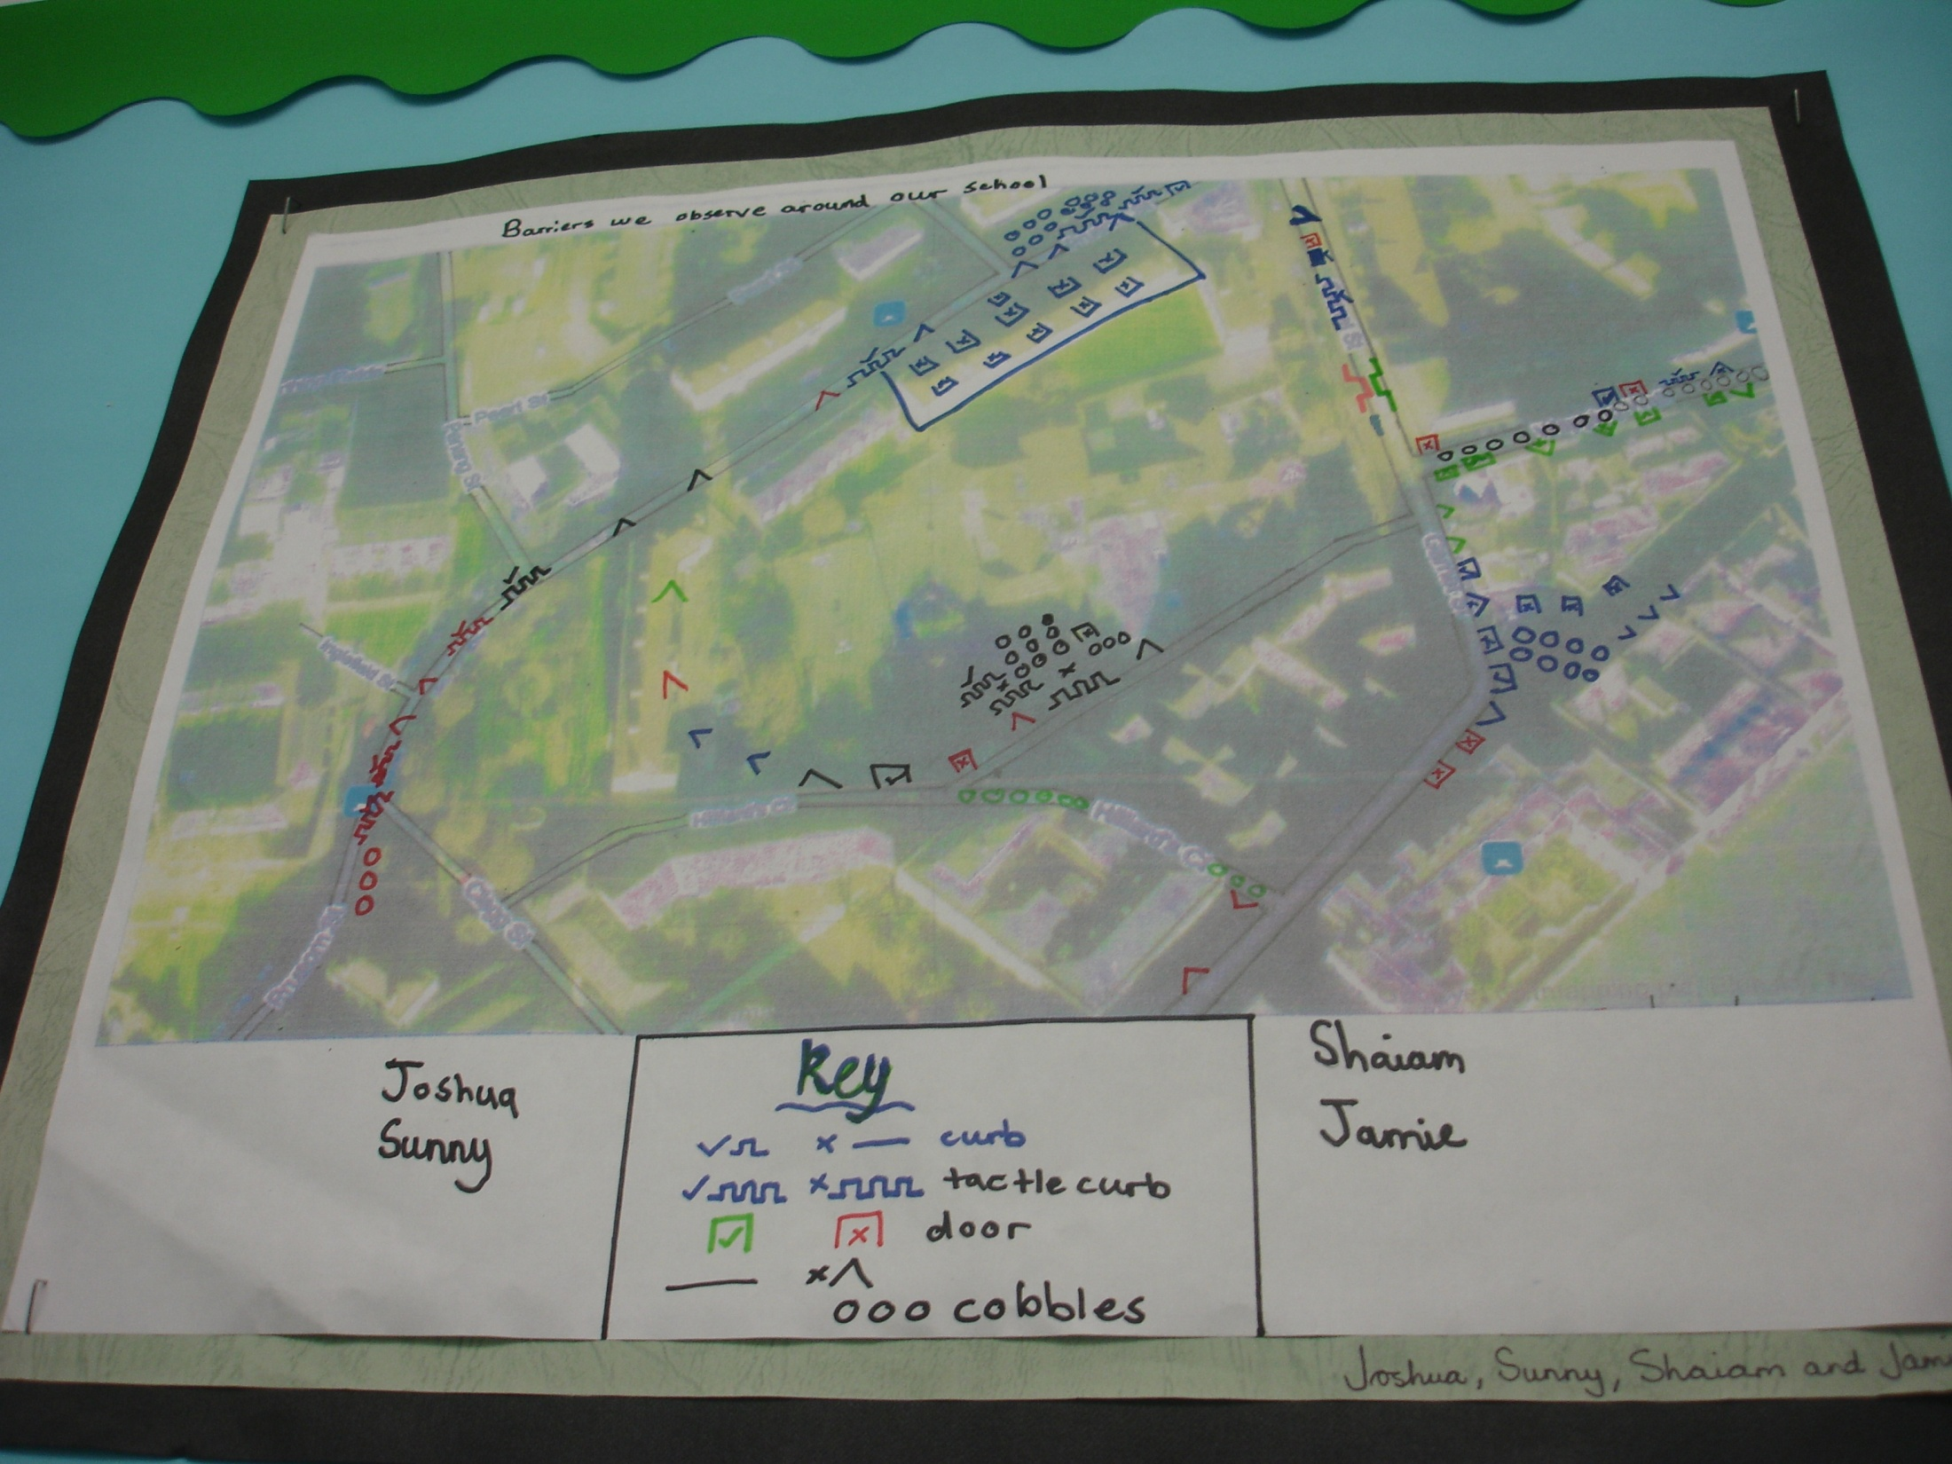
Mapping Local Area for Good and Bad Access
Year 4 Geography
St. Peters

Slide 32
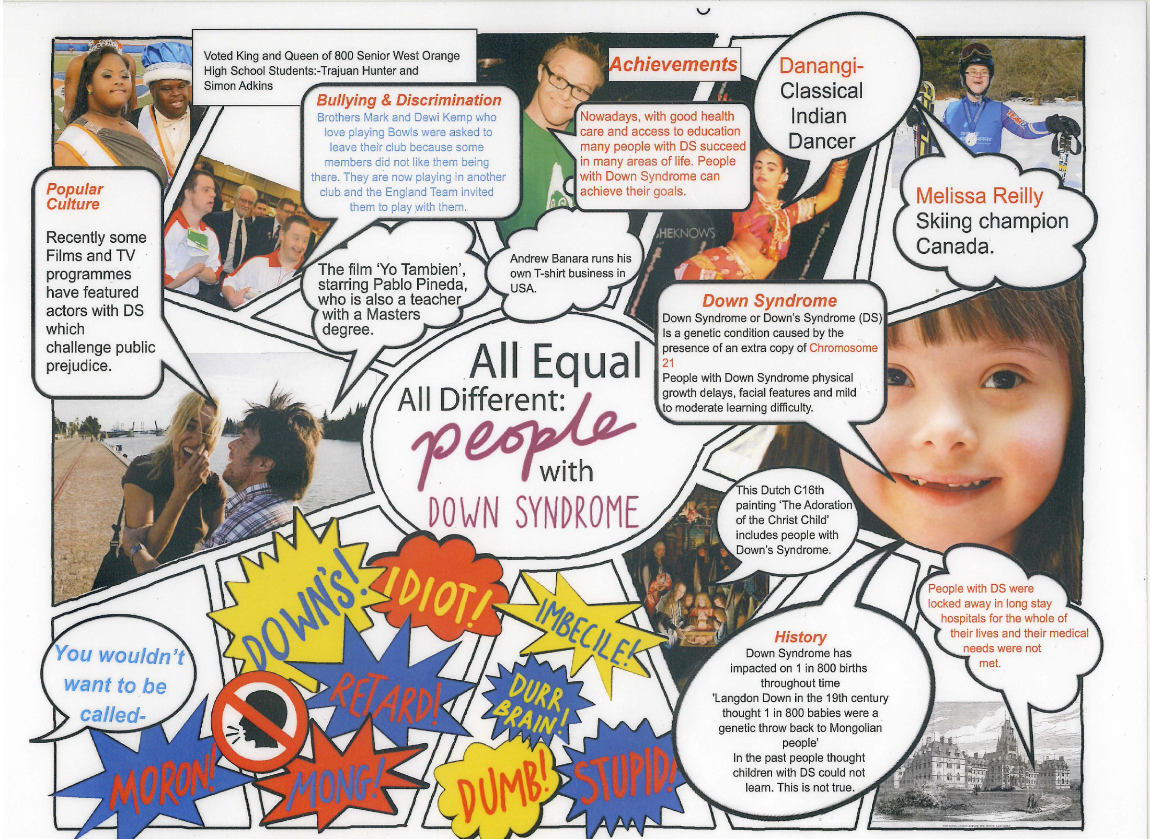

Slide 33
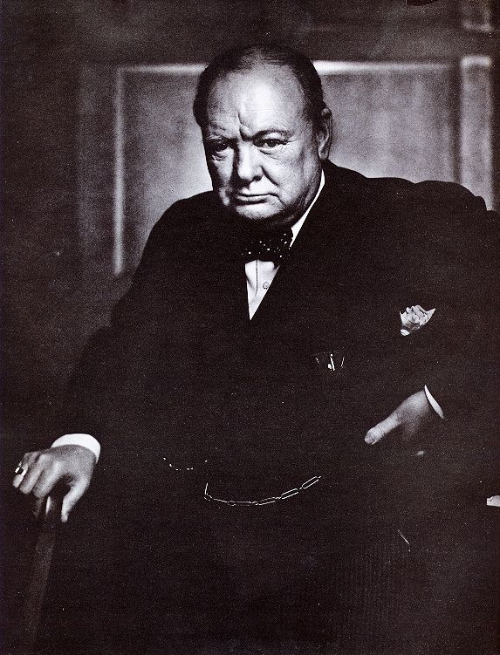
EUGENICIST THINKING
“The unnatural and increasingly rapid growth of the feebleminded classes, coupled with a steady restriction among all the thrifty, energetic and superior stocks constitutes a race danger. I feel that the source from which the stream of madness is fed should be cut off and sealed up before another year has passed.”
Winston Churchill MP, Home Secretary at the time the Mental Deficiency Act of 1913 became law.
1

Slide 34
Getting Rid of the ‘Useless Eaters’ in Nazi Germany 1933-1945
This led to
1 million disabled people being killed in Greater Germany by 1946 as a
BURDEN

Slide 35
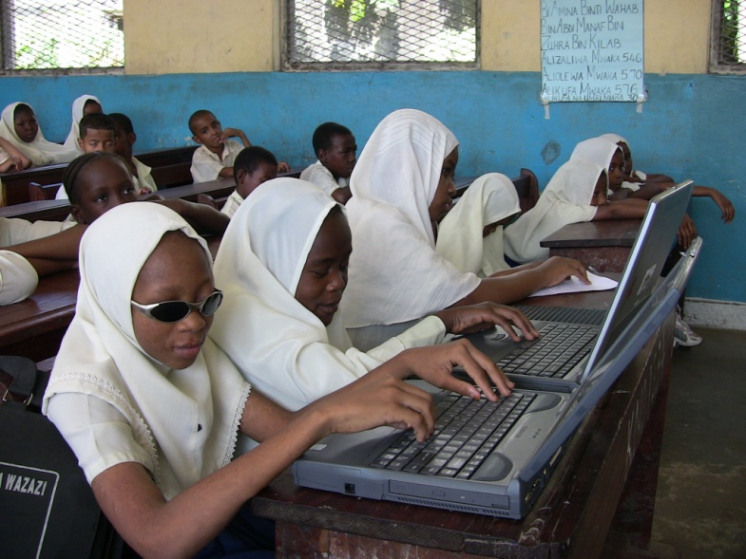
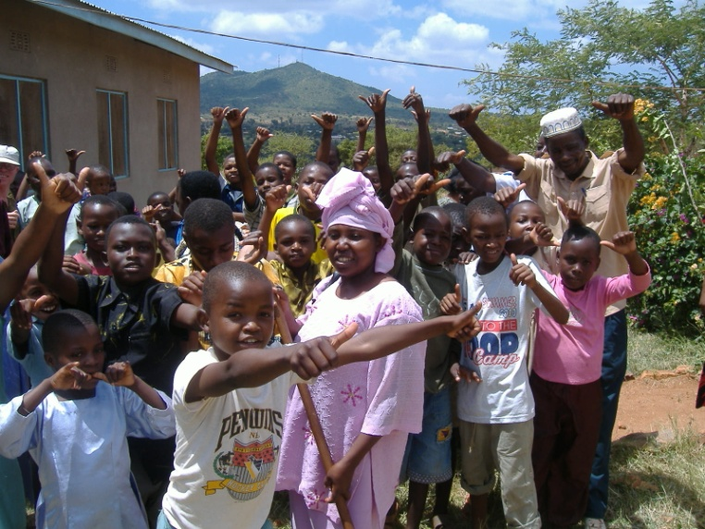
Levers of Change-1 Parents & DPOs
Parents of children with disabilities and Disabled People’s Organisations must be involved at every level.
Zanzibar Association People Developmental Disabilities
MATAJU-Inclusive Education Consortium

Slide 36
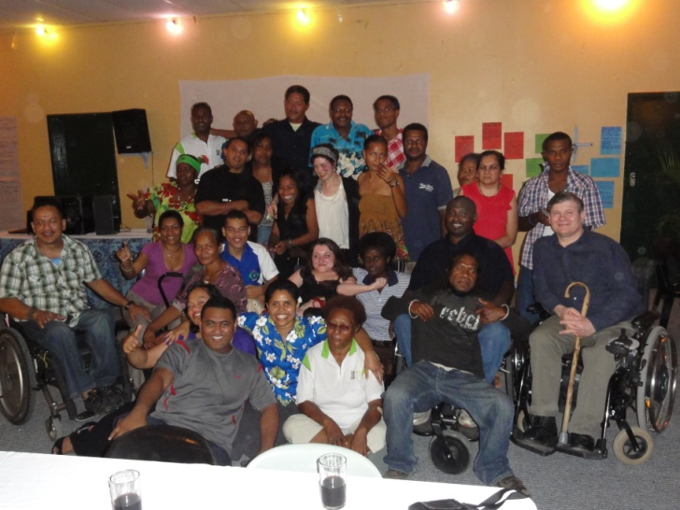
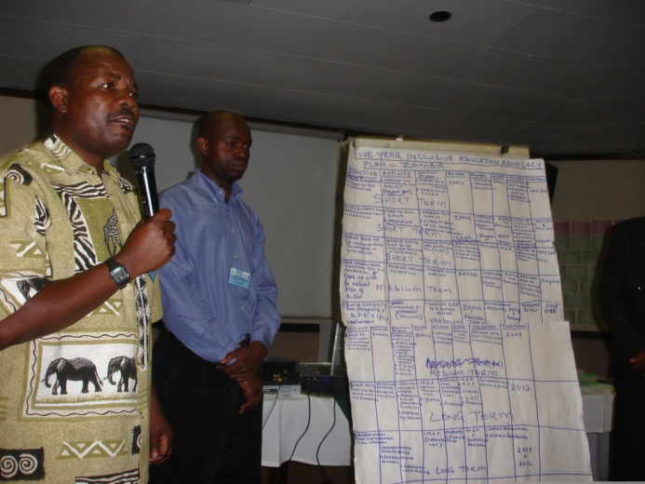
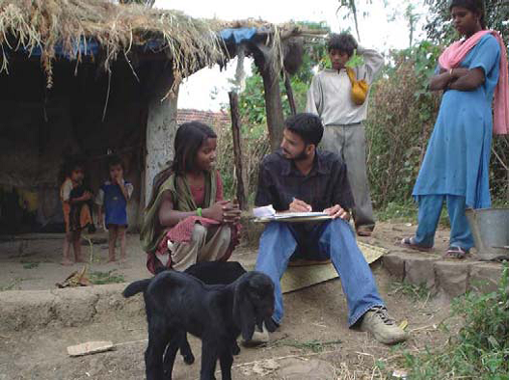
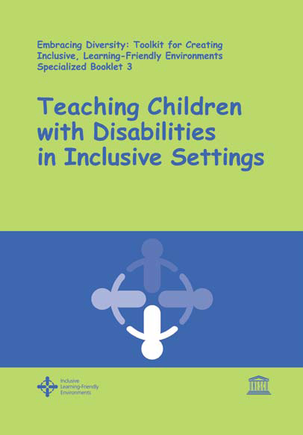
Levers of Change 2-Capacity Building
Disability
Equality
Training for
Teachers,
Parents and
Persons with
Disabilities and their DPOs

Slide 37
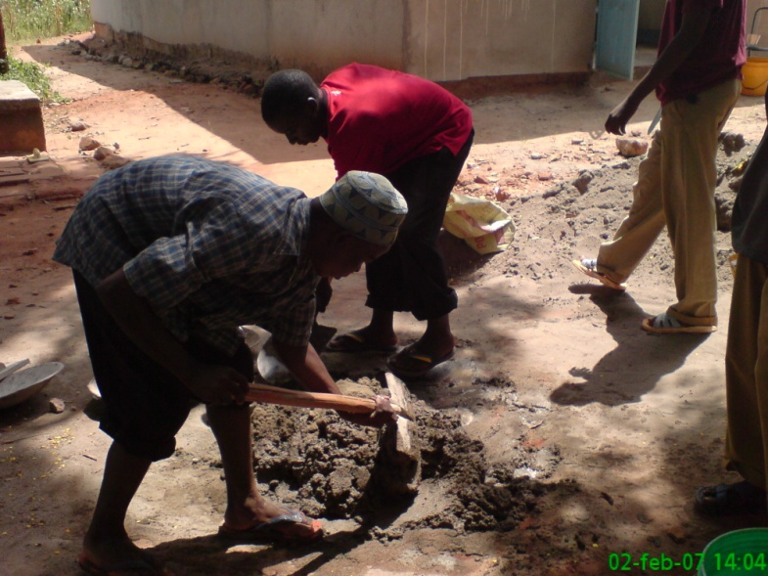
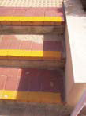

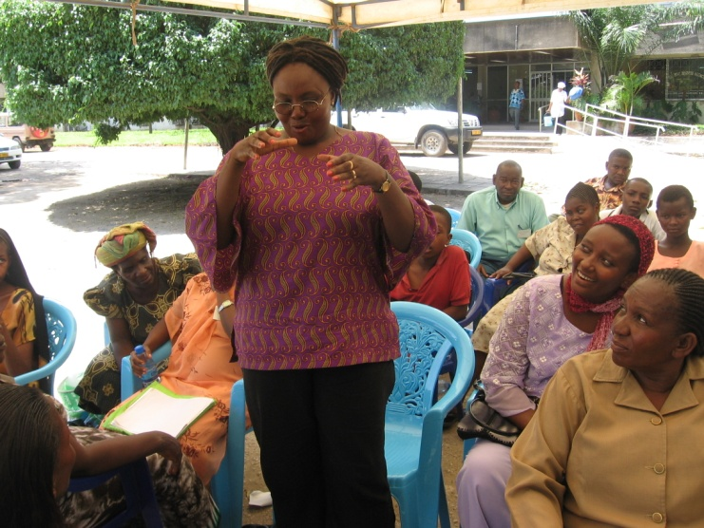
Lever 3 Mobilising Local Community
Mobilising local Community to support the inclusion of children with disabilities.
Bring resources and energy to support campaigning and making buildings accessible

Slide 38
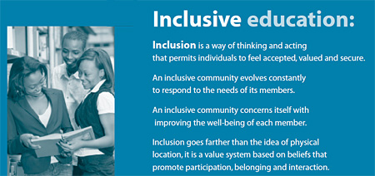
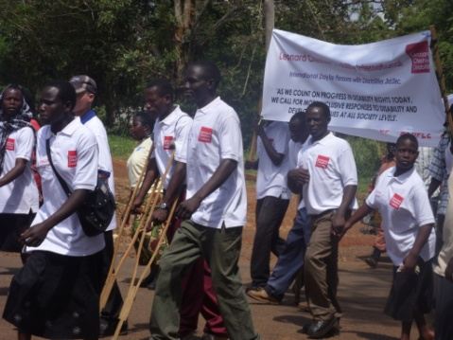
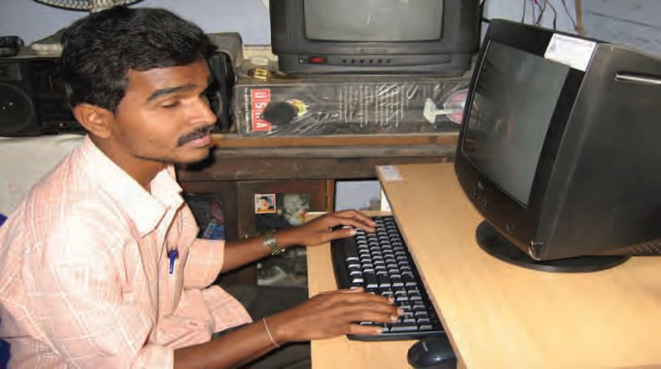
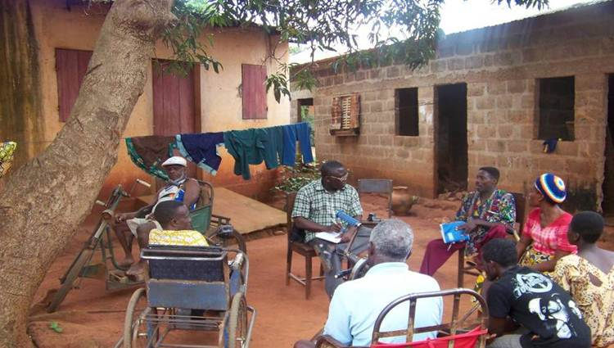
Lever of Change 4 Influencing Government
One Ministry for all children’s education.
Flexible grade system and child centred curriculum.
Incentives for families to enrol disabled children.
Recruit and train disabled teachers.
Promoting Inclusive Education in local community
Community Based Rehabilitation
Funding, Training and developing influence for DPOs
Nothing About Us
Without Us.

Slide 39
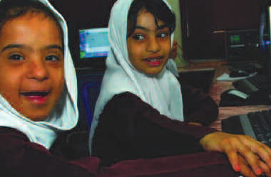
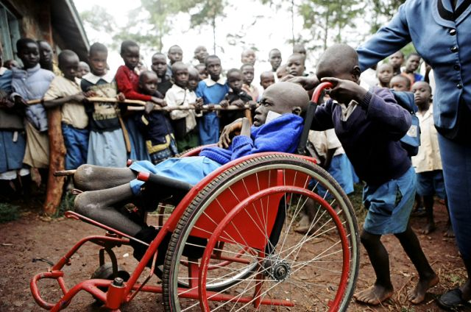
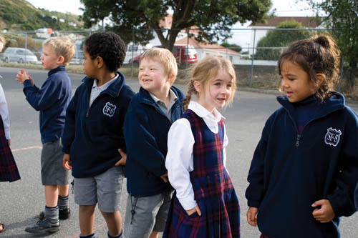
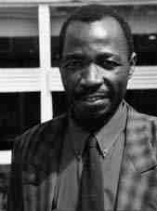
Levers of Change 5-Peer Support
The biggest and most effective resource for inclusion is mobilising peers.
Children feel safe and welcomed at school.
Teachers Intentionally build relationships-Circles of Friends.
Buddies
Challenge all bullying, harassment and violence
UNICEF Child Friendly Schools in 190 countries
Child to child in Zimbabwe

Slide 40
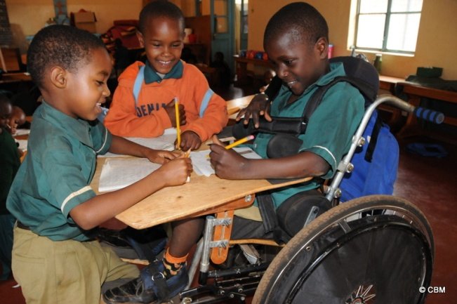
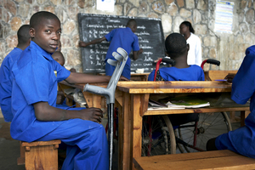
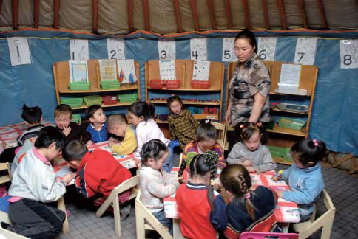
Levers of Change 6 Targeted Funding
Mobilising
International
Community to
increase aid
and donations around SDG 4
Ensuring local control of funding by DPO’s and Parents.
Challenging
Corruption.
Developing Low Tech. solutions for support.
Current decline in Aid since 2010.Needs to rise by 11% a year up to 2030
Government Funding on Education should be 4-6% GDP and 15-20% Government Spending
Need disability inclusion funding demarcated and accountable

Slide 41
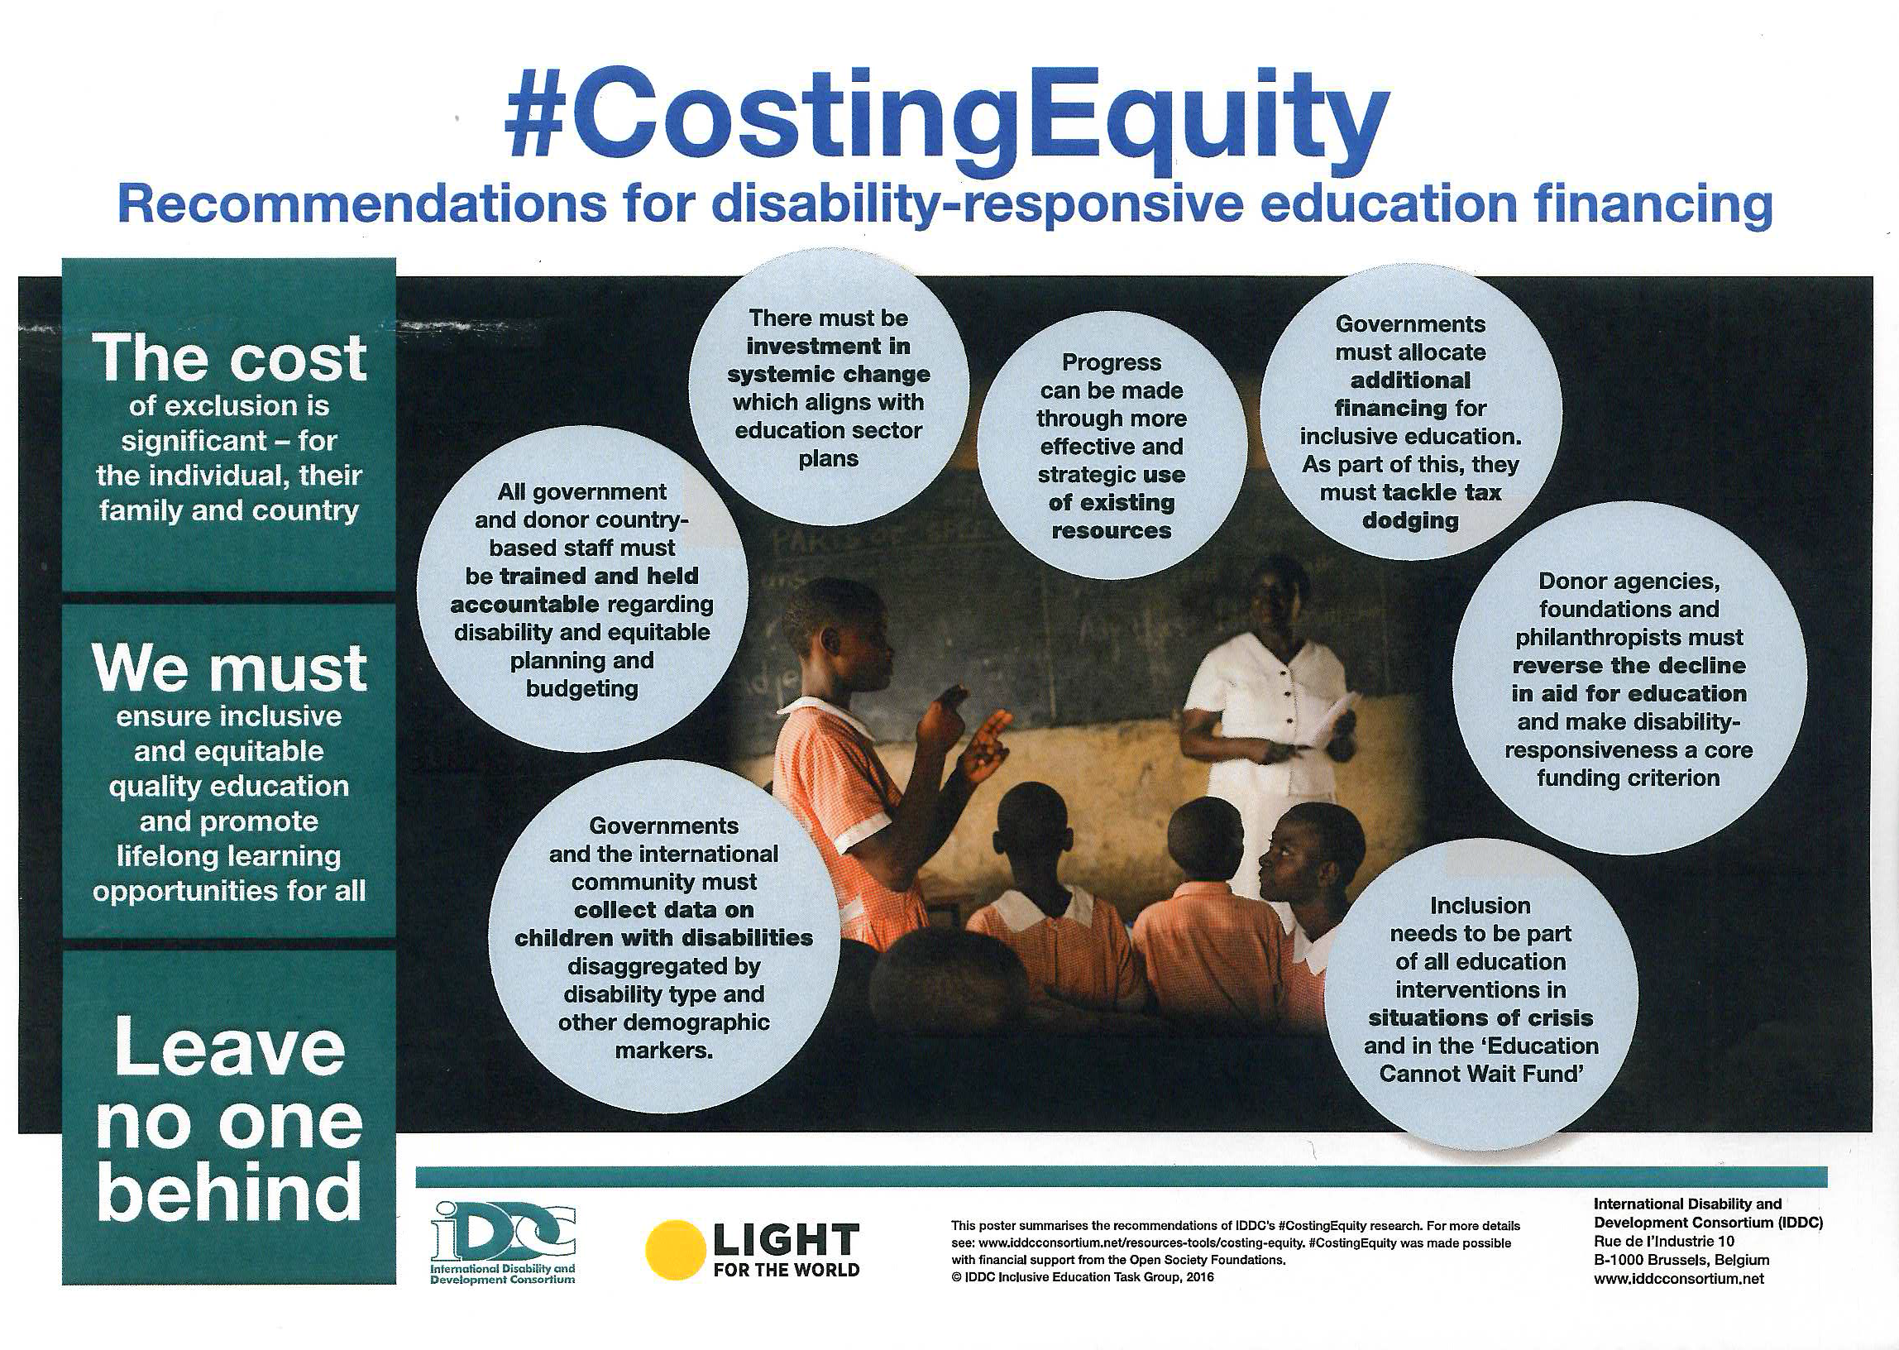

Slide 42
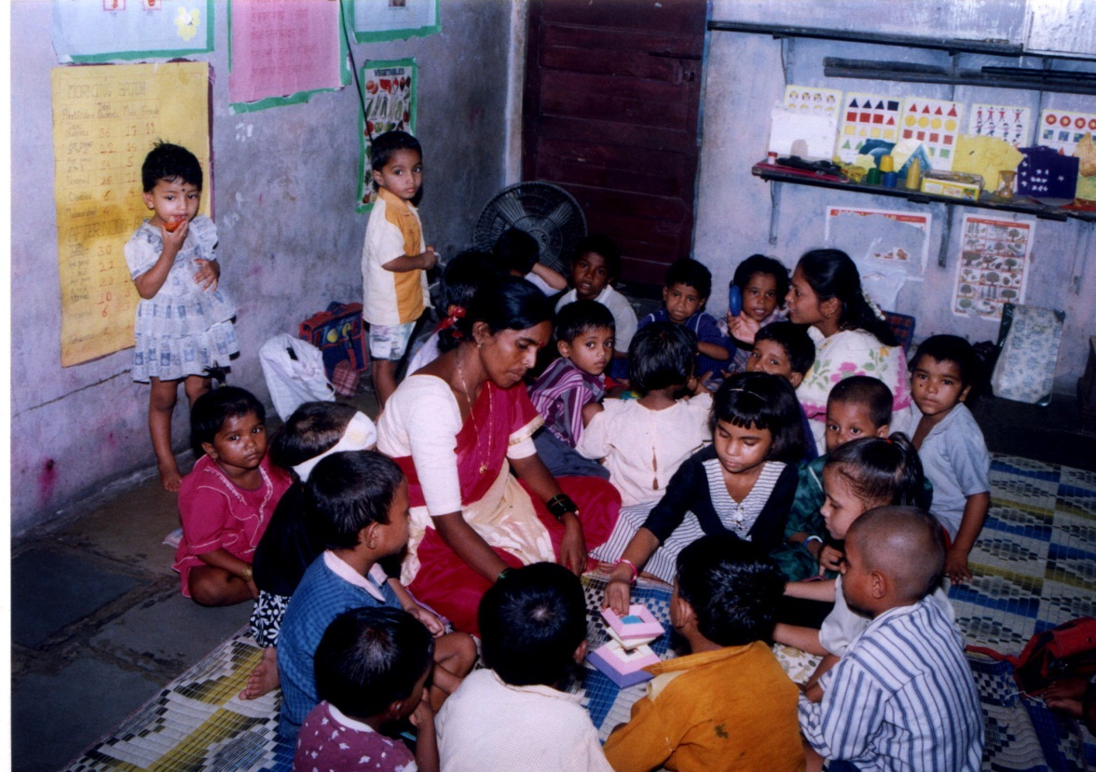
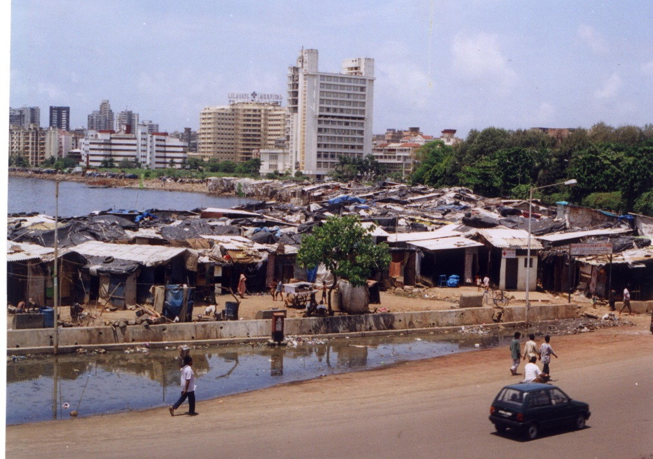
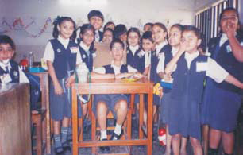
India
Dhravi ,Mumbai, India
Angawadis to School
Now SSA across the whole country
2010 All disabled children a right to education

Slide 43

Schools as Centres of Care and Support (SCCS) KwaZulu Natal
The SCCS has been used and tested, both within and beyond South Africa, as a
model of mainstream care and support in education. The following key principles
have contributed to the model’s success and replicability:
•The school supports communities to respond to poverty, HIV & AIDS, conflict and gender-related issues.
•Meaningful participation by children, youth, the school and its community.
•Culturally and contextually appropriate approaches.
•Existing structures and initiatives are built on.
• A multi-sectoral partnership approach.
Integrated into government plans and budgets.
After successful pilot in Uglo district. All KZN and 5 other SADC countries now operate. MIET

Slide 44

Itinerant teachers for Blind and Visually Impaired
Programmes have been
established in low- and middle income countries including Kenya, Uganda, Malawi, Bangladesh and India
Itinerant teachers travel to mainstream schools to provide individual tutoring in reading and writing Braille (using a frame and stylus) for blind children and those with severe low vision.
Provide other resources.

Slide 45



Mata Escura, Brazil
By 2011 Brazil had established 30,000 resource bases in schools to support the learning of disabled children.
They have Braille facilities
Sign Language and Augmented and Facilitated Communication
Learning materials
2015 Legislation aligned with CRPD.
With 15% of population being people with disabilities the gap is demonstrated that only 3% of those enrolled in early primary grades are CWD.

Slide 46
The evidence for the efficacy of Inclusive Education is Clear
Where there is a choice of Special, segregated schools and mainstream, CWD do considerably better when matched for impairment type and degree in mainstream schools academically.
Their inclusion has a neutral impact on children without disabilities and in a quarter of studies has a positive impact on their learning.
Where it has a positive impact their teachers have been trained in inclusive pedagogy and have inclusive values
The more flexible the learning and assessment approach the better the learners with disabilities do.
Those young people with disabilities who have attended mainstream school and completed are much more likely to get a job, have friends and relationships that those who went to special schools or units are did not attend school.
http://alana.org.br/wp-content/uploads/2016/12/A_Summary_of_the_evidence_on_inclusive_education.pdf

Slide 47
Local Inclusion Initiatives Must Be Brought to National Scale
All Government must adopt a 10 year Plan to develop Inclusive Education for All children and young people with disabilities
Ring fence funding for Access program, Reasonable Accommodations and Support
All Non disabled children and young people should be involved and receive Disability equality and Anti Bullying Training
This is a fundamental Human Rights Issue in line with General Comment No.4
Challenge complacency , reaction and corruption
Every local area needs an inclusion resource centre
Funding must be locally controlled and globally provided
Must be a bottom up movement
Challenge Special Needs and the Medical Model Paradigm must be challenged at all levels of education and replaced by Inclusive Pedagogy
Must be Twin Track approach
Need high tech and low tech solutions
All teachers must receive adequate Disability Equality and Inclusion training both in-service and pre-service
To develop inclusion we need a democratic inclusive movement.
Will be of benefit to all and to society in developing the SDGs!

Slide 48

Which way for the world?
Sustainability or Eco- Catastrophe
Competition or Collaboration
Developing Disability Equality & Inclusion will make a lasting shift to people.
Inclusion or Exclusion?
People or Profits!
We make our own history, but not in circumstances of our own making!
The Choice Rests with Us All!

